Slide 1
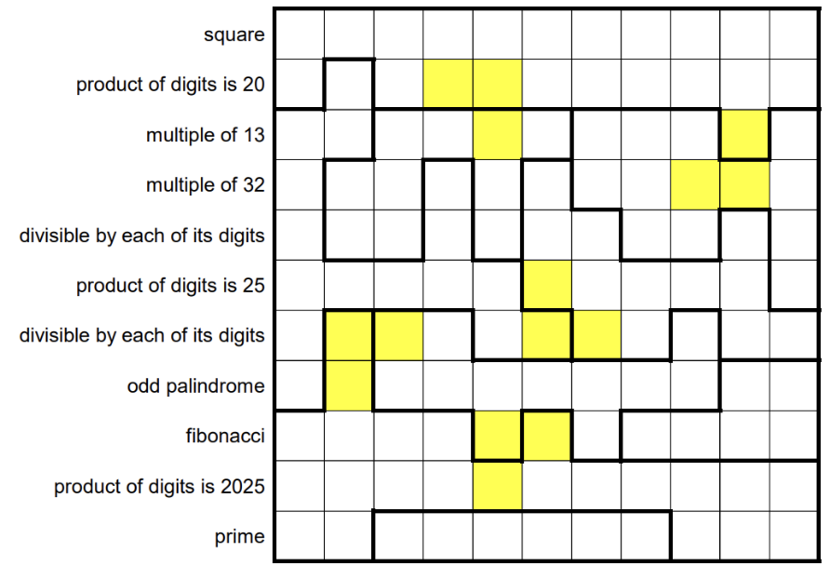
2/0 | 3 | 4 | 2 | 2 | 2 | 5 | 2/0 | 3 | 2 | 4
5 | 4 | 2/0 | 2X | 2X | 5 | 2/0 | 2 | 5 | 2 | 2/0
4/0 | 5 | 6 | 5 | 5X | 5/0 | 6 | 5 | 4/0 | 2X | 6
9 | 6 | 5/0 | 7 | 5 | 2 | 4 | 5 | 4X | 4X | 4/0
4/0 | 5 | 5 | 5 | 5 | 1 | 1 | 4/0 | 8 | 1 | 6
5 | 5 | 4/3 | 5 | 5 | 1X | 1 | 1 | 1/0 | 1 | 4
4/3 | X | X |  | 4 | 4X | 1X | 1 |  | 1 | 1
4 | X
 |  |  |  | X | X
 |  |  |  | X

Slide 2
 | 3 | 4 | 2 | 2 | 2 | 5 |  | 3 | 2 | 4
4,5 | 4,5 |  | X2 | X2 | 5 |  | 2,5 | 2,5 | 2
 |  |  |  | X |  |  |  |  | X2
 |  |  |  |  |  |  |  | X | X
5 | 5 | 5 | 5 | 5 | 1X | 1 | 1 | 1 | 1
 | X | X |  |  | X | X
 | X
 |  |  |  | X | X
 |  |  |  | X

